Slide 1

Port Stress Index – Simplifying multi-source data for decision-making
Notes:
I’m going to talk about a time where I translated a complex, multi-source analytical problem into a clear, decision-ready insight for stakeholders, through the development of a Port Stress Index.

Slide 2


The Problem & Complexity
The Problem
Why It Was Complex
•
•
Multiple port metrics
Different units and scales
•
•
No single view of pressure
Partial signals from each metric
•
Risk of inconsistent interpretation
•
High volatility in data
Notes:
As part of our weekly publication, we monitor shipping activity across UK ports to understand economic activity and potential disruption. (pause)
However, the data was fragmented across multiple metrics — including ship counts, gross tonnage, tanker units, and average time spent in port. (pause)
These metrics could be analysed individually, but they often gave conflicting signals.
For example, a port might show high ship counts but relatively low cargo volume. (pause)
This made it difficult to answer a simple but important question:
“Are ports currently under unusual pressure?” (pause)
This became particularly important during periods of global disruption, where stakeholders needed a clear and timely view. (pause)
The complexity came from three areas:
First, the metrics were in different units and scales — making direct comparison difficult.
Second, each metric only provided a partial view of activity.
And third, the data was highly volatile, meaning short-term changes could be misinterpreted. (pause)
So the challenge was not just analytical — it was about simplifying multiple signals into a clear, consistent insight for decision-making.

Slide 3
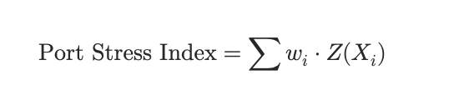
My Approach
Standardised inputs
Combined into single index
Defined ‘normal’ vs ‘high pressure’
Notes:
To address this, I led the development of a composite Port Stress Index. (pause)
I standardised the different inputs so they could be compared on a common scale and combined them into a single measure of overall pressure.
A key step was defining what “normal” looks like using historical patterns, so deviations could be clearly interpreted. (pause)
This allowed us to move from multiple disconnected metrics to a single, coherent signal.
Importantly, the focus was not just on building the index, but on ensuring it was usable and easily understood by stakeholders.

Slide 4
How I Communicated It
Single time series per port
Clear comparison across ports
Simple interpretation (normal / high)
Focus on decisions, not methods
Notes:
Rather than presenting multiple datasets or focusing on the technical detail, I prioritised usability. (pause)
I presented the output as a simple time series, allowing stakeholders to track changes in port pressure over time.
I also enabled direct comparison across ports by placing them on a common scale. (pause)
To make interpretation easier, I introduced simple categories such as “within expected range” and “above normal pressure.”
I was also clear about limitations — explaining what the index captures, and where additional context is needed. (pause)
This shifted the conversation from
“What does this data mean?”
to
“What action should we take?”

Slide 5
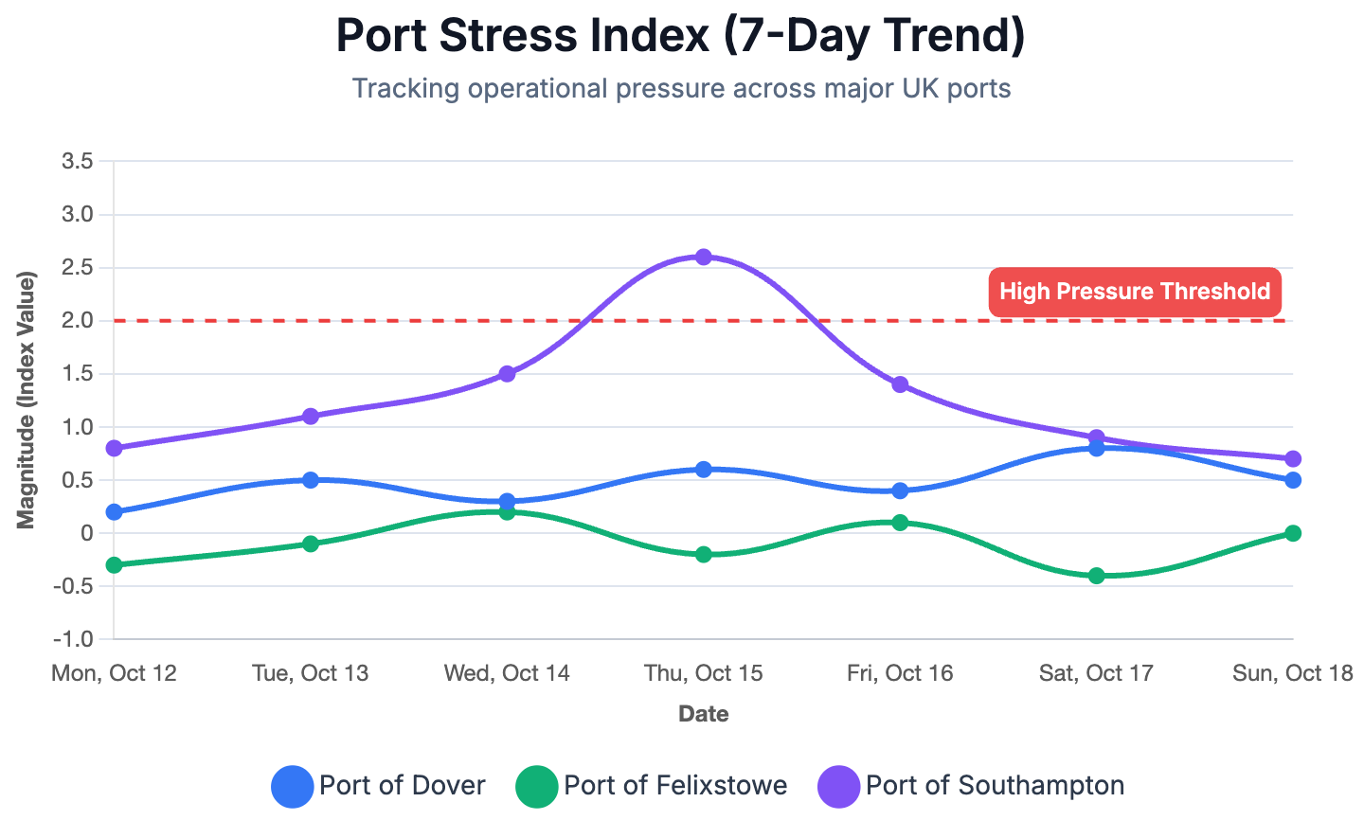

Impact
Faster understanding
Reduced misinterpretation
Consistent narrative
Notes:
This approach allowed us to assess port conditions quickly without needing to interpret multiple datasets. (pause)
It reduced the risk of misinterpreting short-term volatility and provided a consistent view across ports.
For example, we could identify sustained pressure, rather than reacting to isolated spikes in individual metrics. (pause)
From a real-time perspective, it acted as an early signal of potential disruption or increased activity.
Its real value was when used alongside other indicators — such as transaction data or footfall — where it helped build a more complete picture of economic conditions. (pause)
Overall, it improved the clarity, consistency and timeliness of our analysis, supporting better decision-making.

